Slide 1
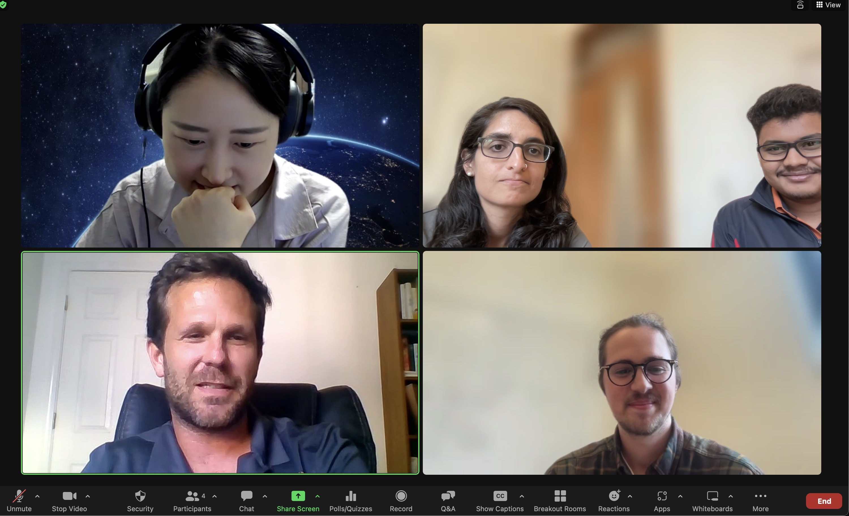
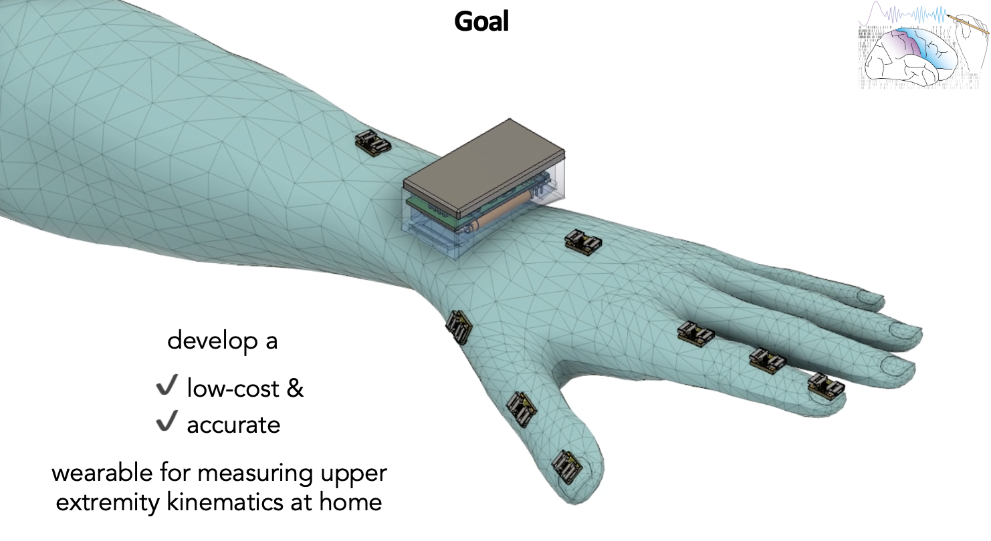

Slide 2
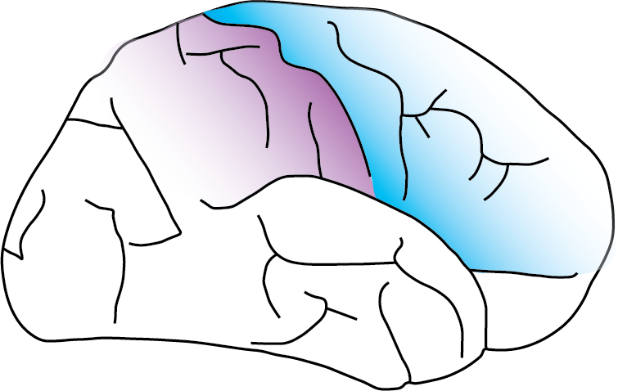
Welcome to the
Sensorimotor Neural Engineering Lab
@ UC Berkeley!

Slide 3
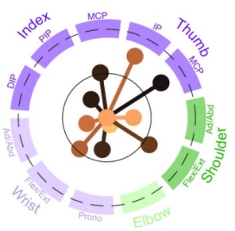

Slide 4
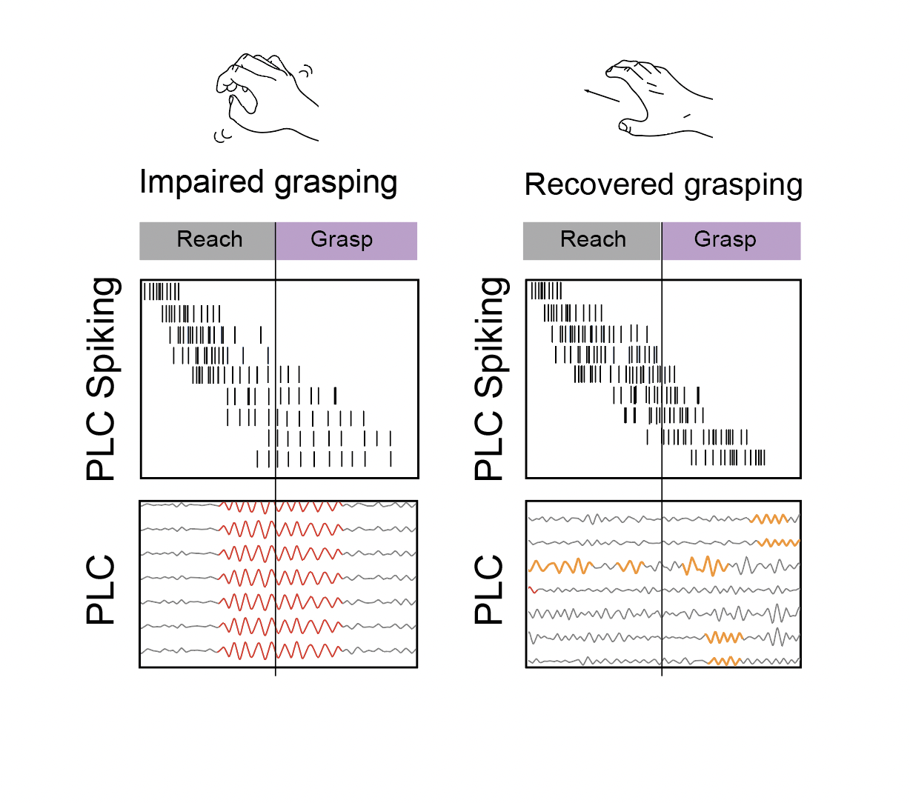
Global beta dominant
Local beta dominant

Slide 5
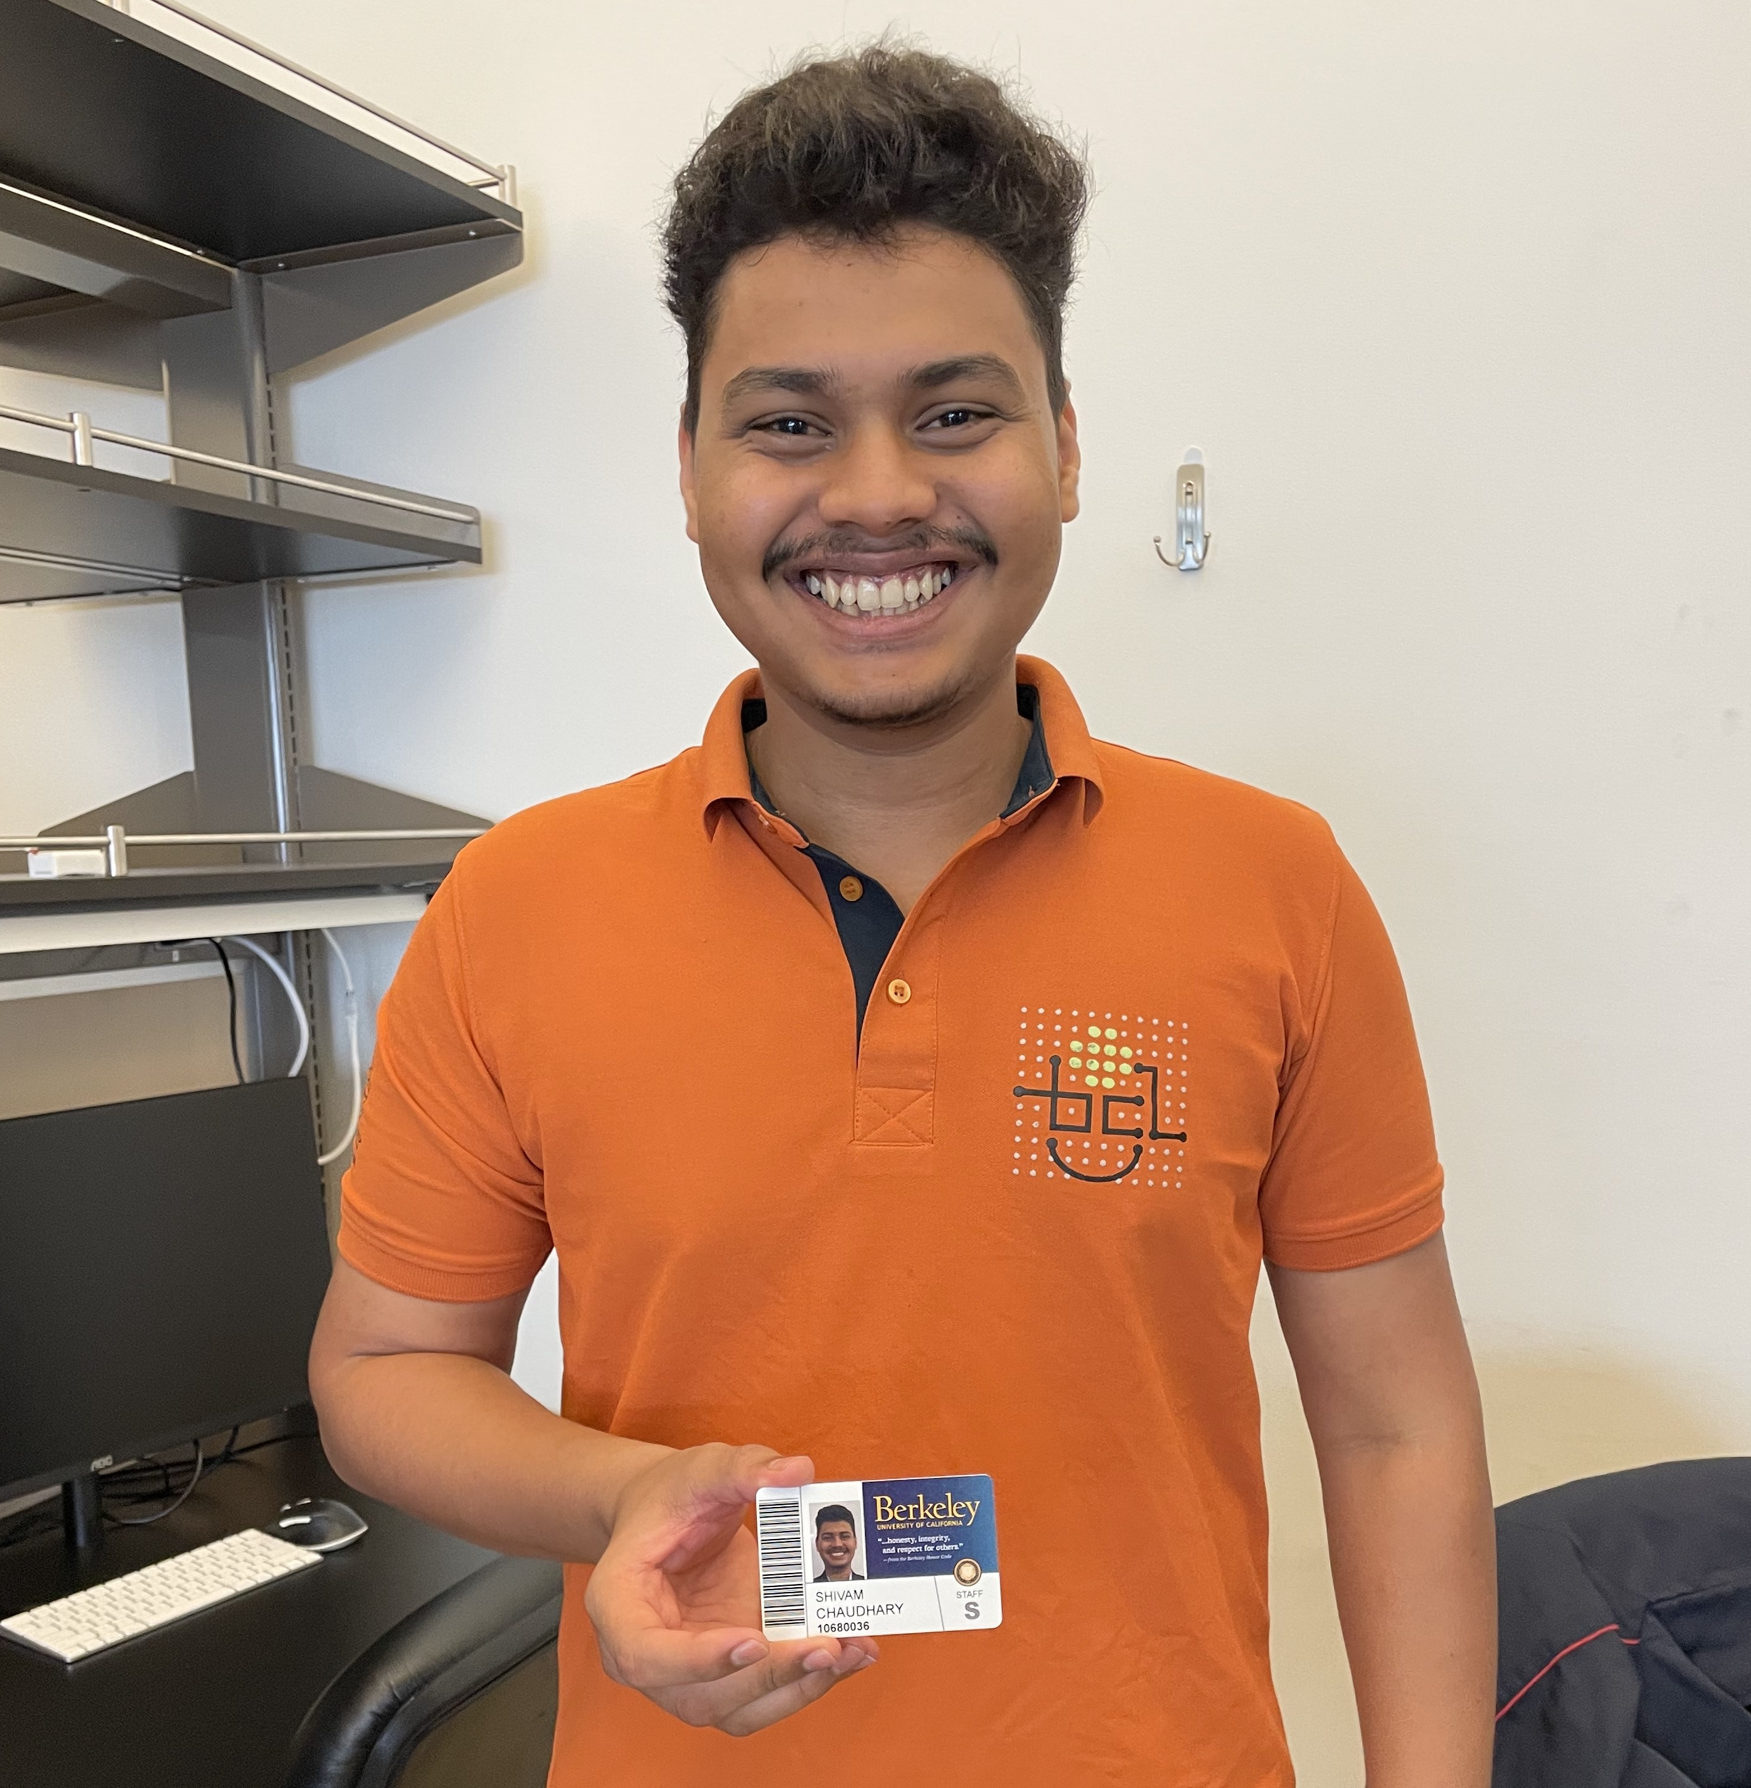

Slide 6
Sim
Co

Slide 7


Slide 8


Slide 9
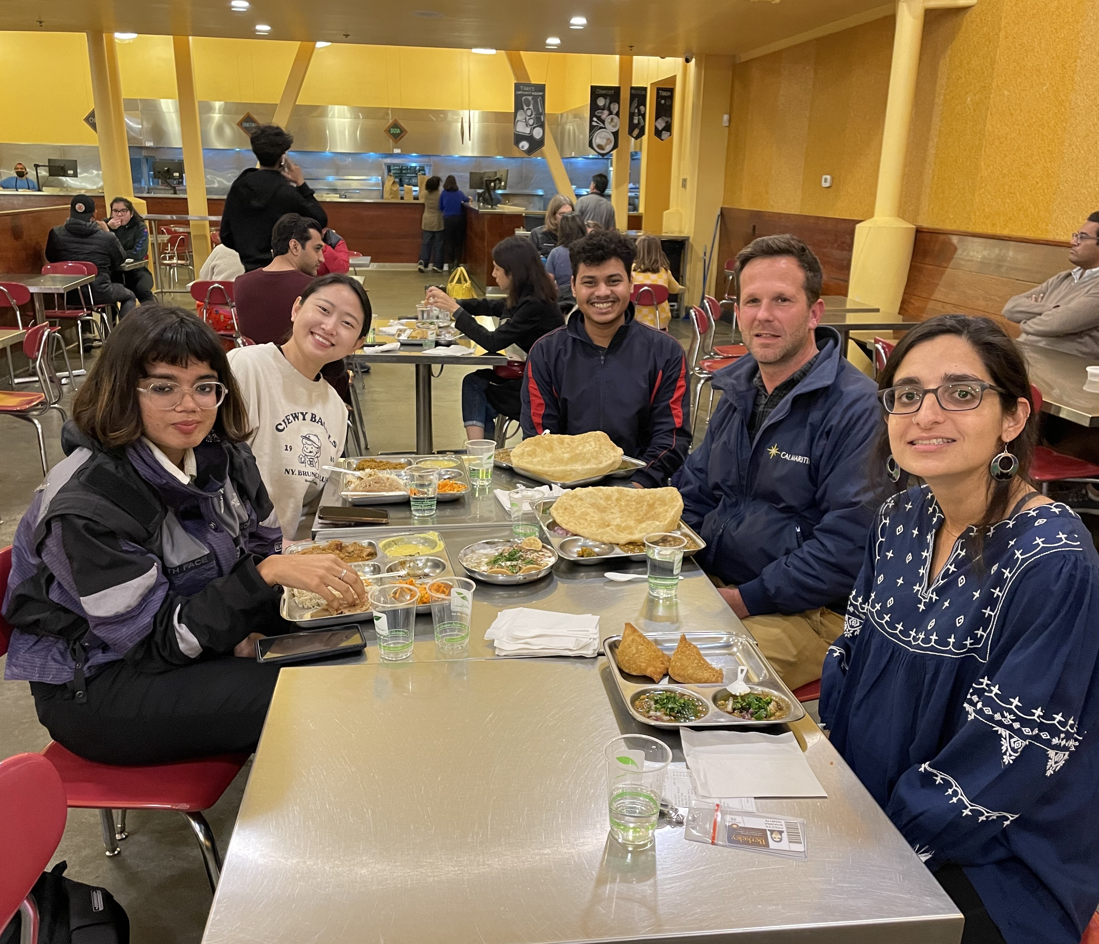

Slide 10
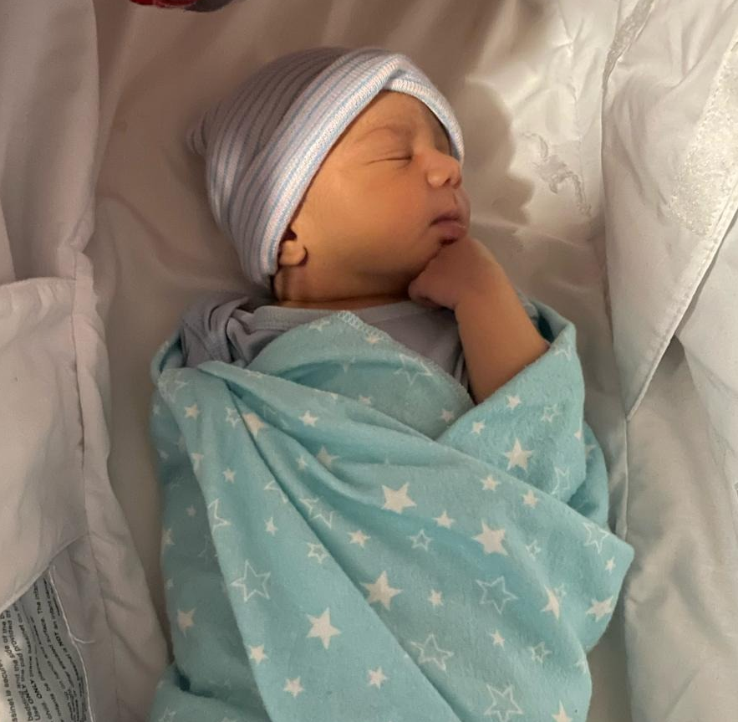

Slide 11


Slide 12


Slide 13


